Slide 1
CSC 250: Foundations of Computer Science I
Fall 2023 - Lecture 12
Amitabha Dey
Department of Computer Science
University of North Carolina at Greensboro

Slide 2
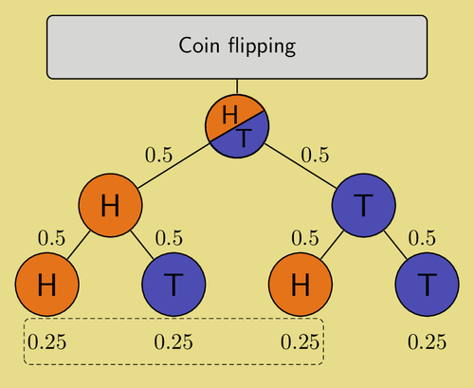
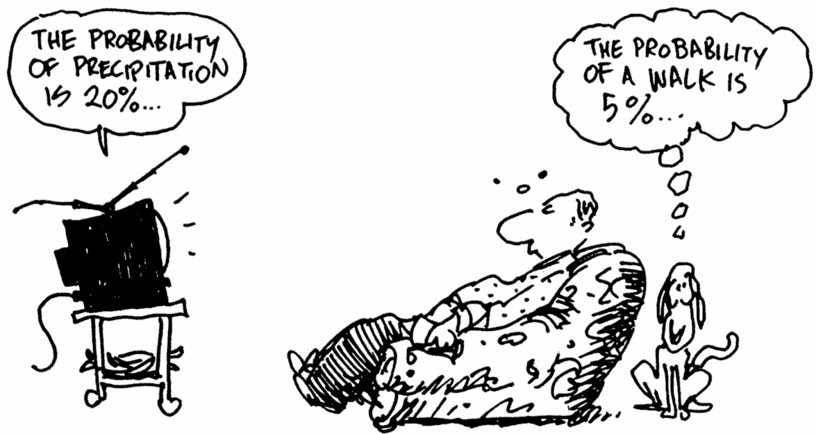
Sample Spaces, Events, Probabilities
Rolling an ordinary six-sided die is a familiar example of a random experiment, an action for which all possible outcomes can be listed, but for which the actual outcome on any given trial of the experiment cannot be predicted with certainty.
In such a situation we wish to assign to each outcome, such as rolling a two, a number, called the probability of the outcome, that indicates how likely it is that the outcome will occur.
Similarly, we would like to assign a probability to any event, or collection of outcomes, such as rolling an even number, which indicates how likely it is that the event will occur if the experiment is performed.
Image credit - https://texample.net/

Slide 3
Sample Spaces, Events, Probabilities
Rolling an ordinary six-sided die is a familiar example of a random experiment, an action for which all possible outcomes can be listed, but for which the actual outcome on any given trial of the experiment cannot be predicted with certainty.
In such a situation we wish to assign to each outcome, such as rolling a two, a number, called the probability of the outcome, that indicates how likely it is that the outcome will occur.
Similarly, we would like to assign a probability to any event, or collection of outcomes, such as rolling an even number, which indicates how likely it is that the event will occur if the experiment is performed.
A random experiment is a mechanism that produces a definite outcome that cannot be predicted with certainty. The sample space associated with a random experiment is the set of all possible outcomes. An event is a subset of the sample space.
Image credit - https://texample.net/

Slide 4
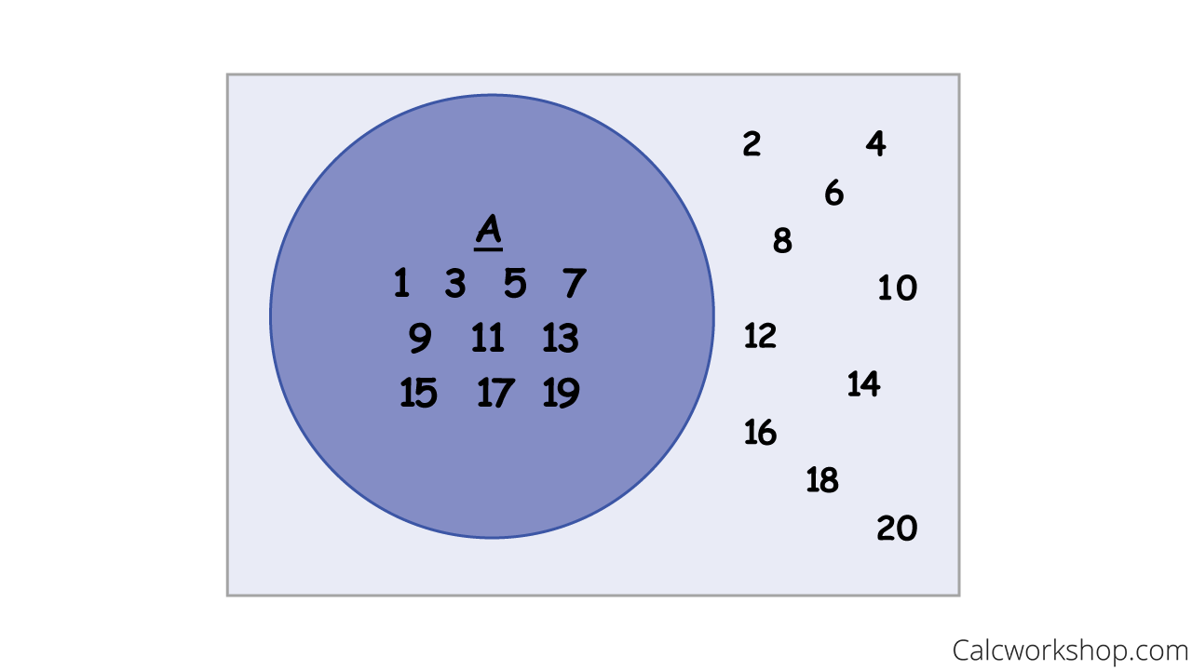
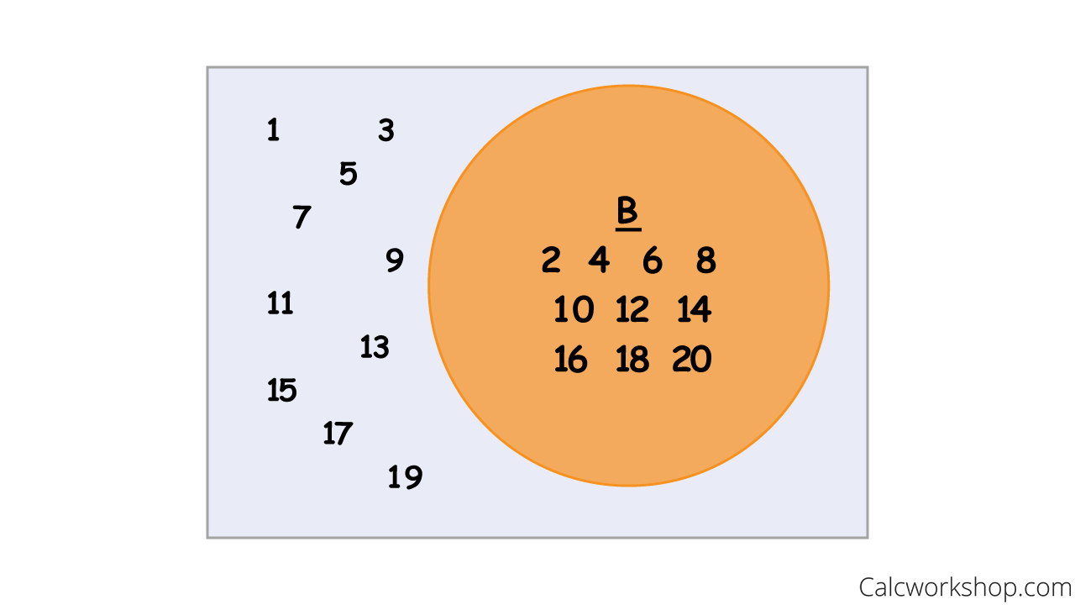
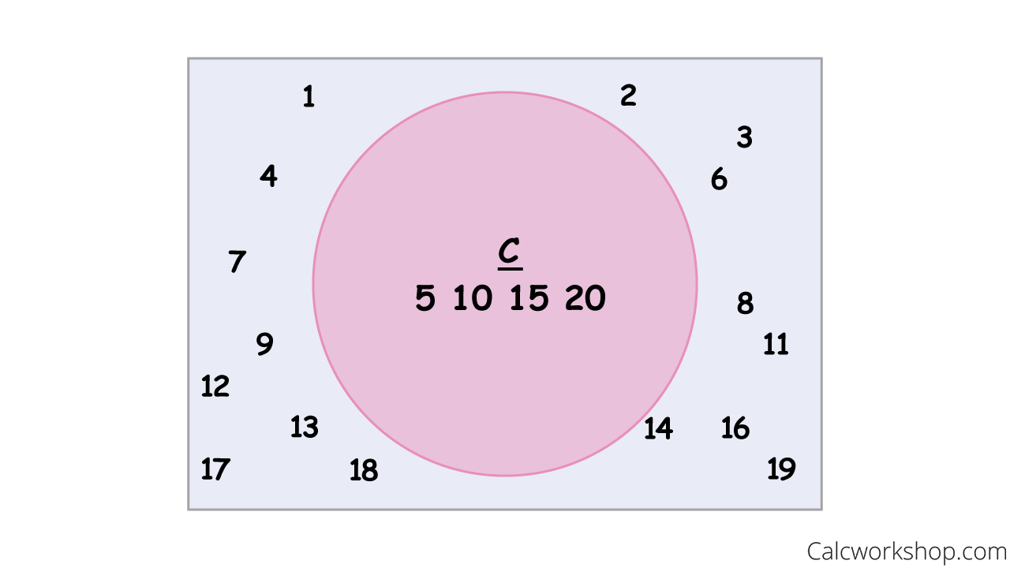
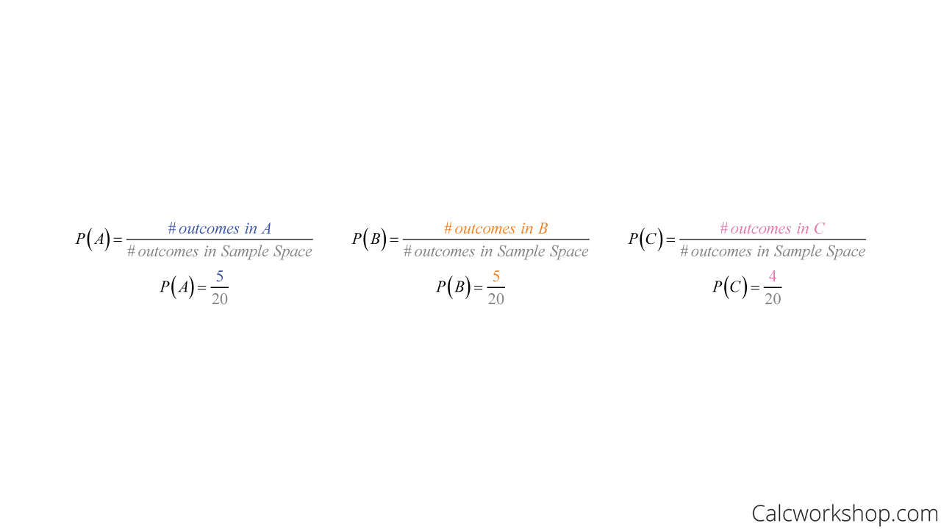
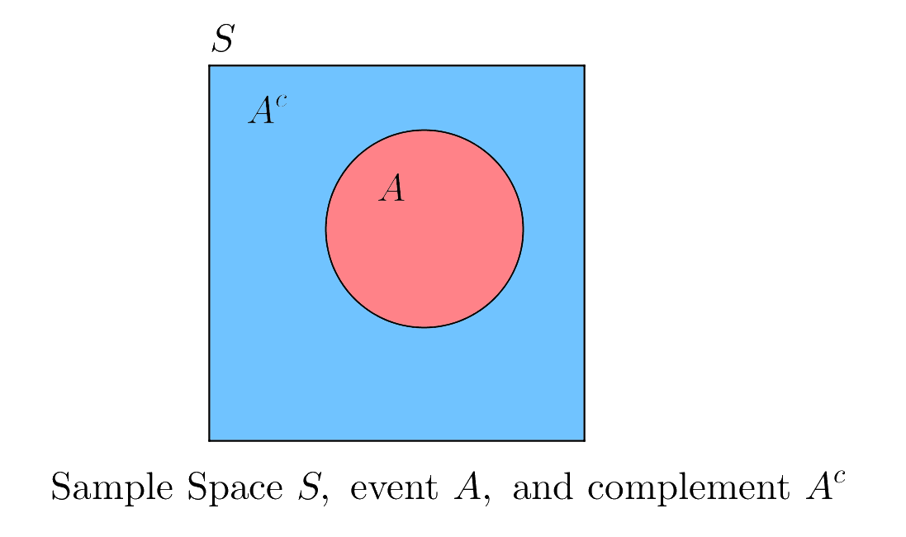
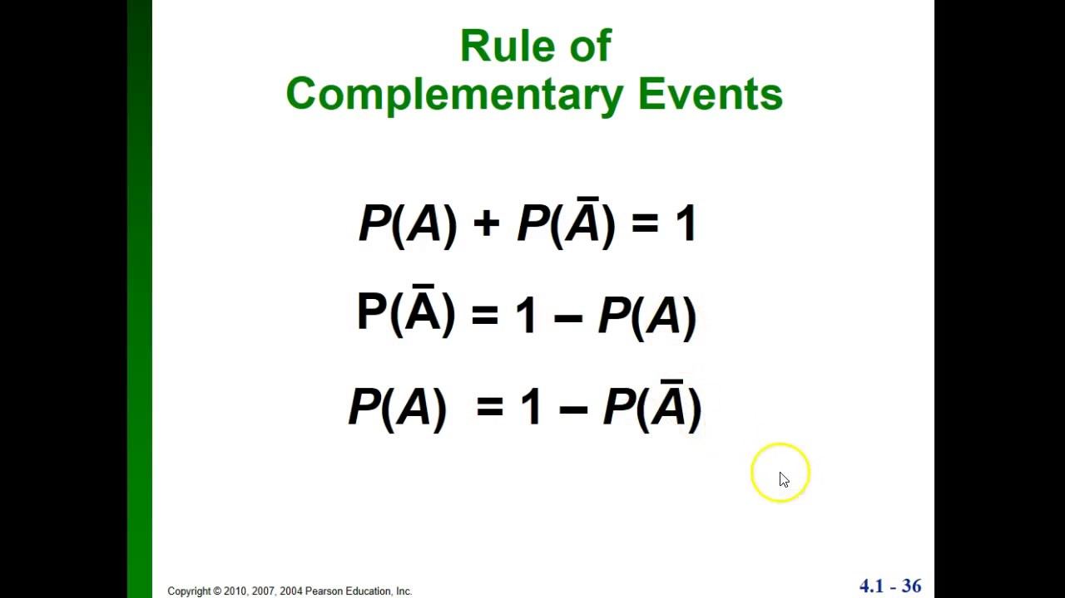
Probability Theory
Probability is a measure of the likelihood of an event to occur. Many events cannot be predicted with total certainty. We can predict only the chance of an event to occur i.e., how likely they are going to happen, using it.
Probability can range from 0 to 1, where 0 means the event to be an impossible one and 1 indicates a certain event.
The probability of all the events in a sample space adds up to 1.
Image credit - https://calcworkshop.com/
Complementary Events
The complement of A consists of all the outcomes in which the event A does not occur.
Image credit - https://brilliant.org/

Slide 5
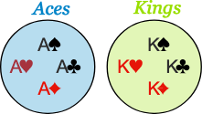
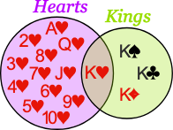
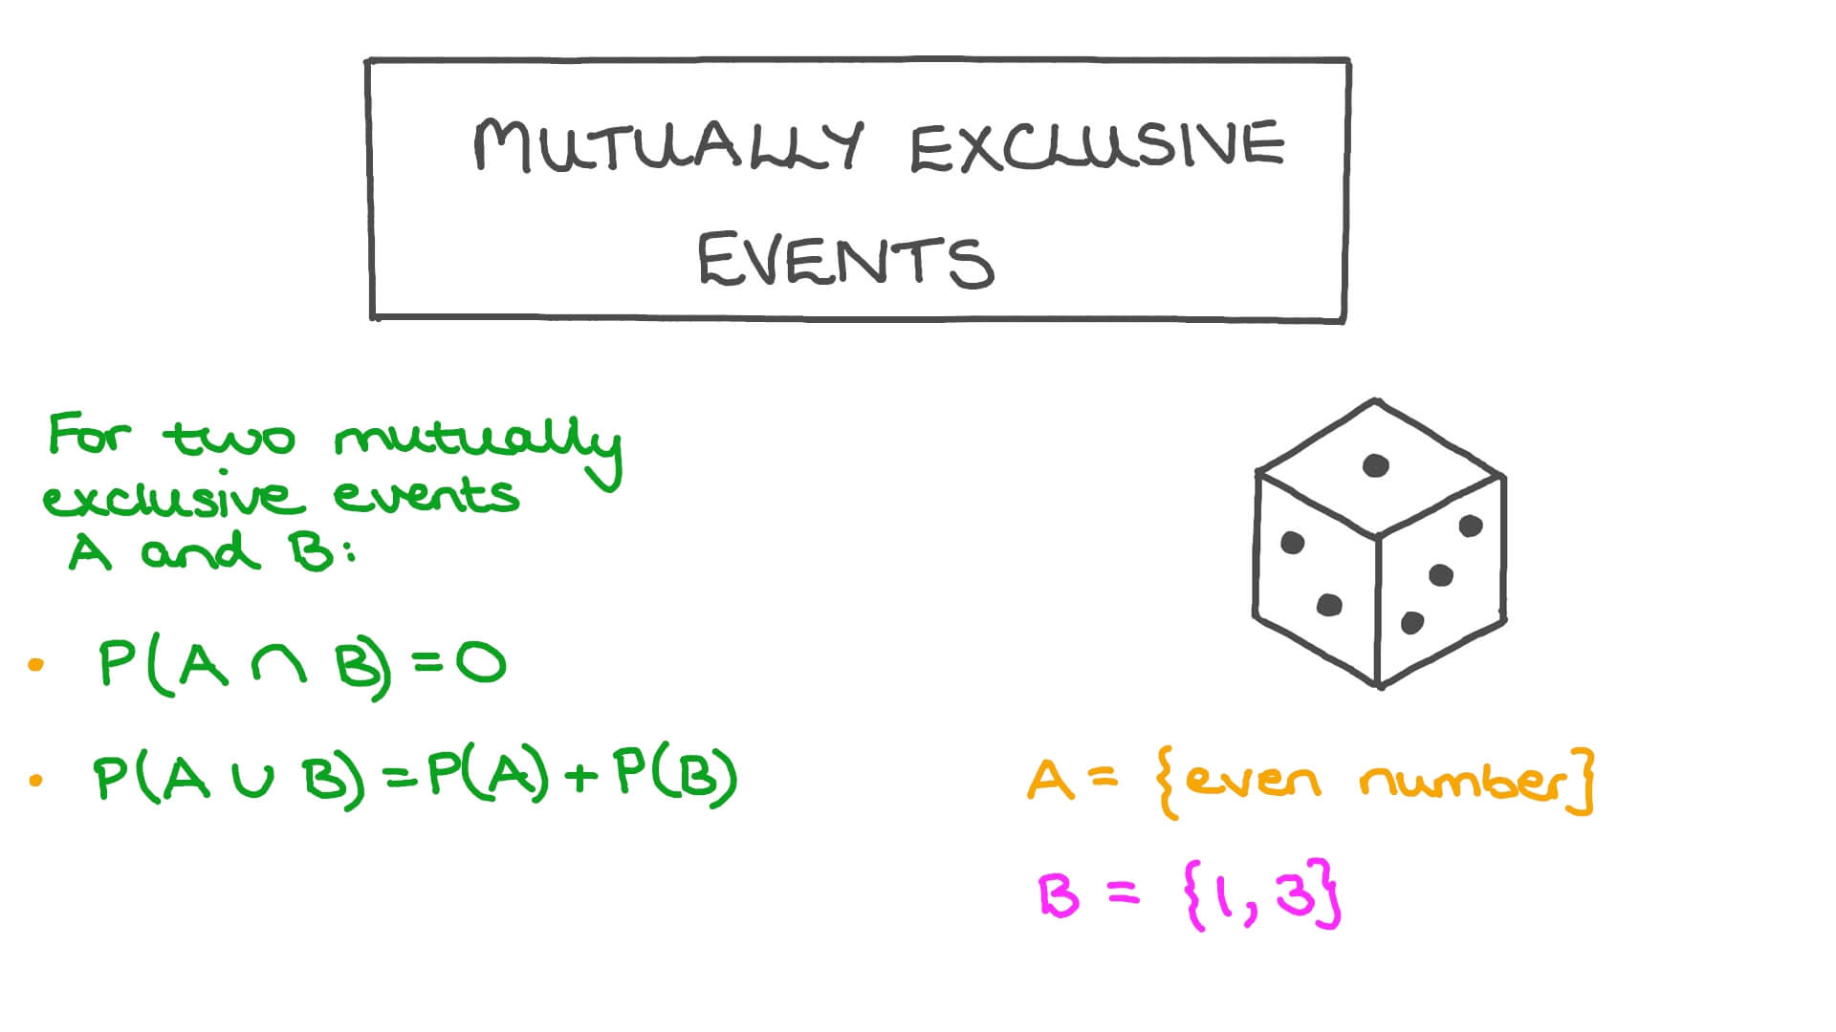
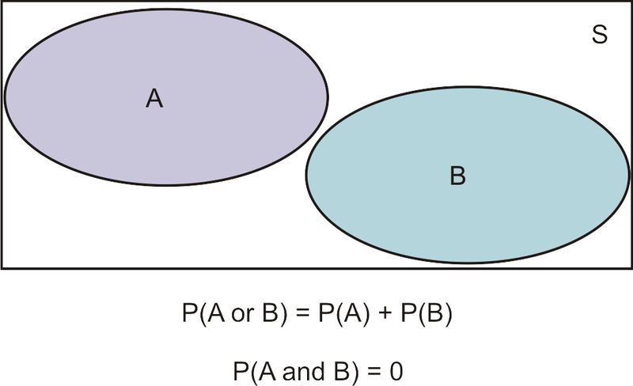
Mutually Exclusive/Disjoint Events
In probability theory, two events are said to be mutually exclusive if they cannot occur at the same time or simultaneously. In other words, mutually exclusive events are called disjoint events. If two events are considered disjoint events, then the probability of both events occurring at the same time will be zero.
The days of the week - you cannot have a scenario where it is both Monday and Friday!
The outcomes of a dice roll
Selecting a 'diamond' and a 'black' card from a deck
Aces and Kings are Mutually Exclusive (can't be both)
Hearts and Kings are
not Mutually Exclusive (can be both)
Image credit - https://www.mathsisfun.com/
Image credit - https://media.nagwa.com/
Image credit - https://www.ck12.org/

Slide 6
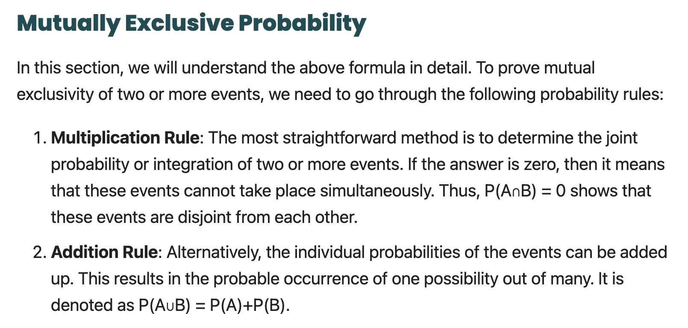
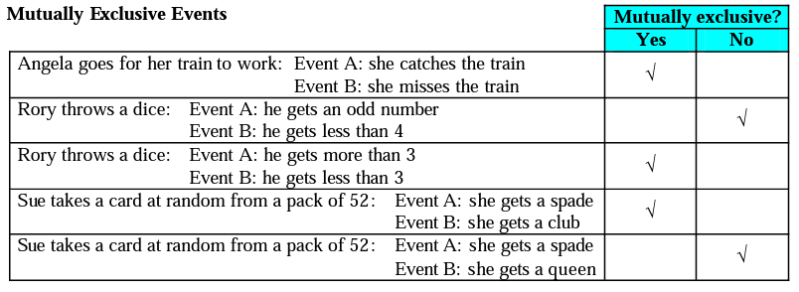
Mutually Exclusive/Disjoint Events
In probability theory, two events are said to be mutually exclusive if they cannot occur at the same time or simultaneously. In other words, mutually exclusive events are called disjoint events. If two events are considered disjoint events, then the probability of both events occurring at the same time will be zero.
The days of the week - you cannot have a scenario where it is both Monday and Friday!
The outcomes of a dice roll
Selecting a 'diamond' and a 'black' card from a deck
Aces and Kings are Mutually Exclusive (can't be both)
Hearts and Kings are
not Mutually Exclusive (can be both)
Image credit - https://www.mathsisfun.com/
Image credit - https://media.nagwa.com/
Image credit - https://www.ck12.org/

Slide 7
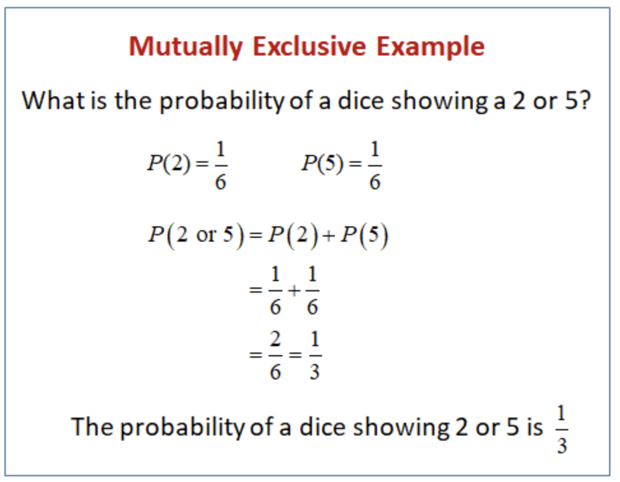
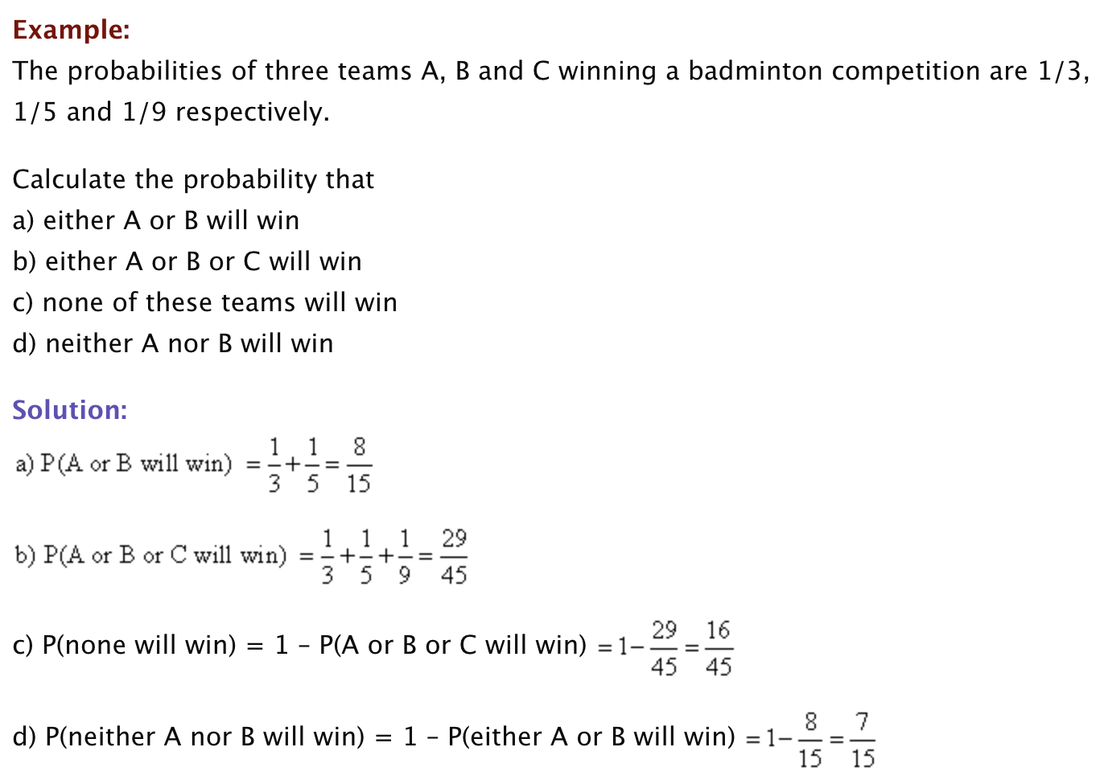
Mutually Exclusive/Disjoint Events
Examples
Image credit - https://www.onlinemathlearning.com/

Slide 8
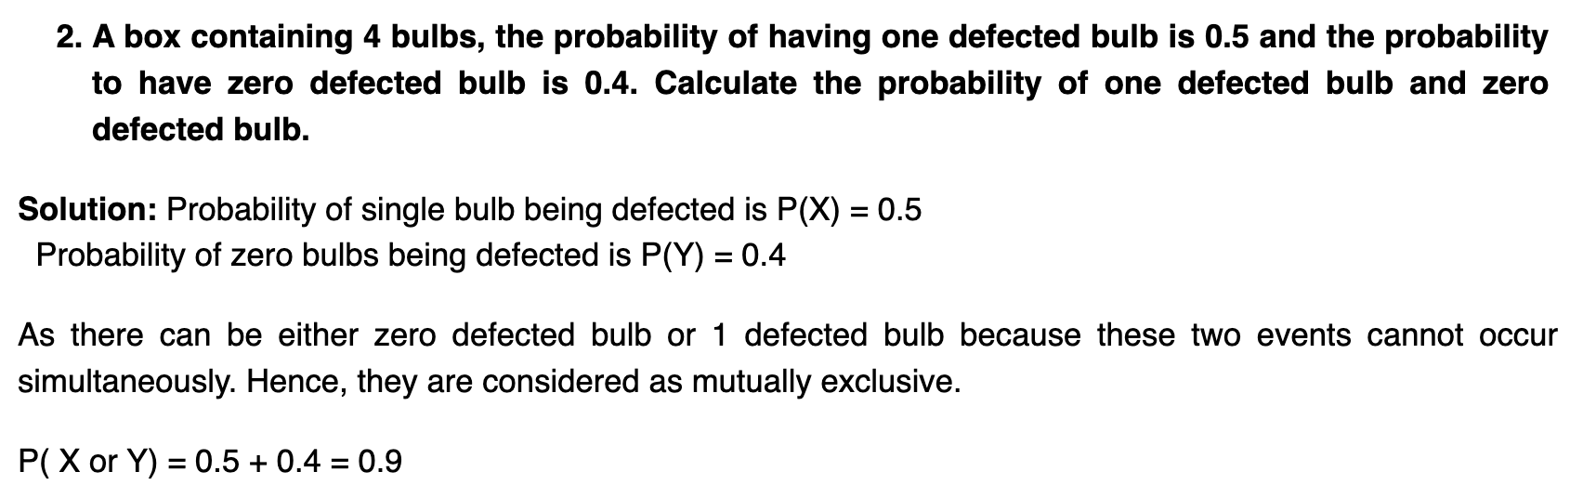
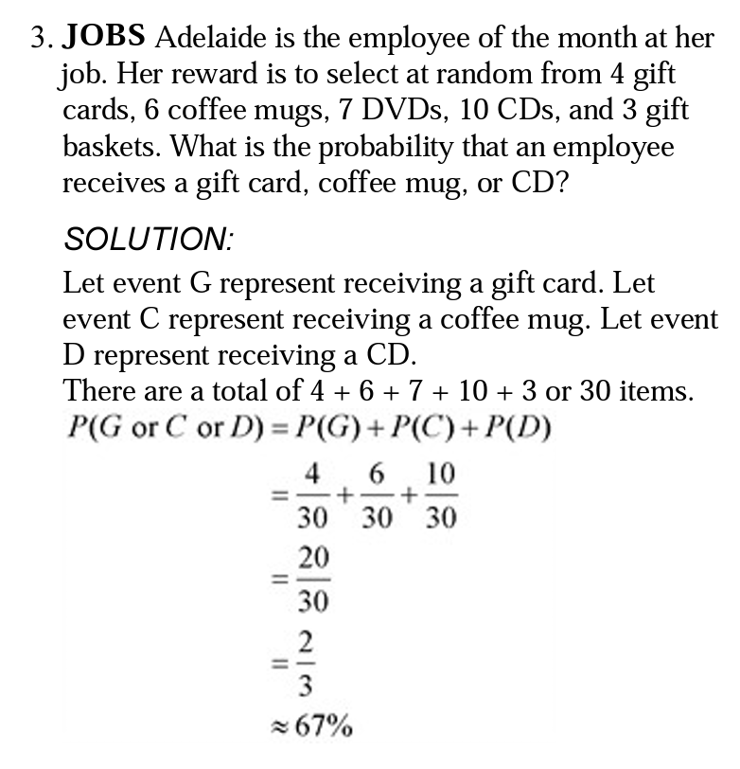
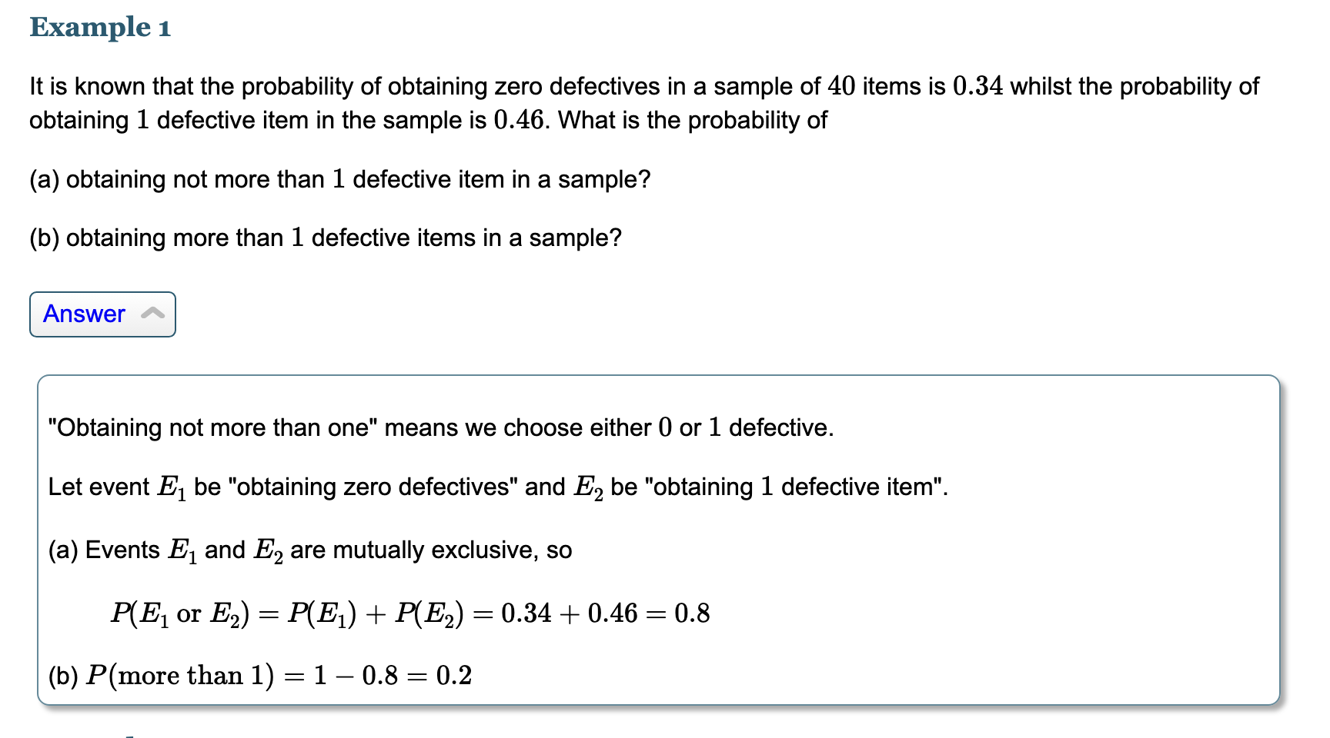
Mutually Exclusive/Disjoint Events
Examples
Image credit - https://www.vedantu.com/
Image credit - www.chino.k12.ca.us
Image credit - https://www.intmath.com/

Slide 9
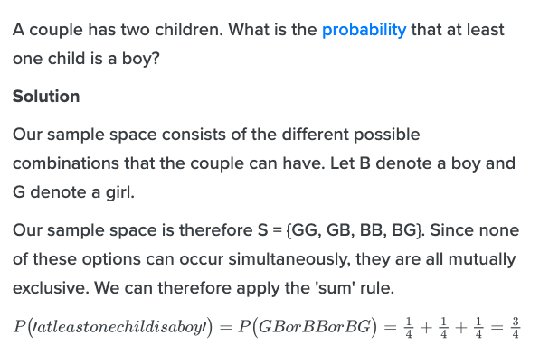
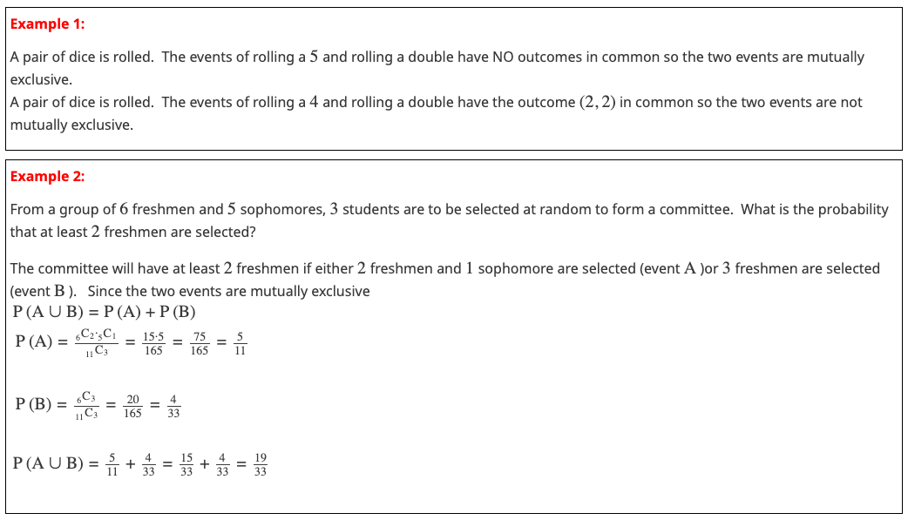
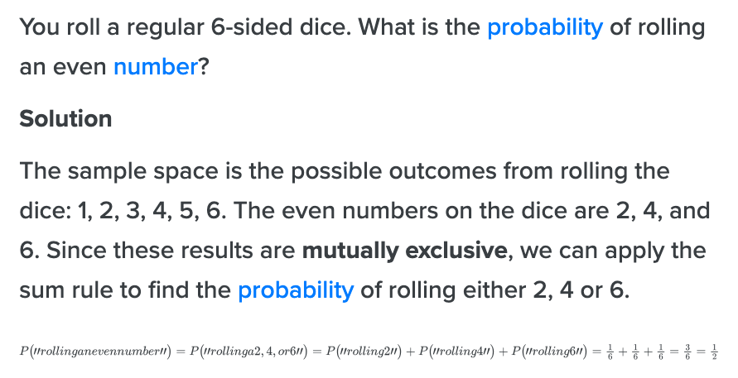
Mutually Exclusive/Disjoint Events
Examples
Image credit - https://www.varsitytutors.com/
Image credit - https://www.hellovaia.com/

Slide 10
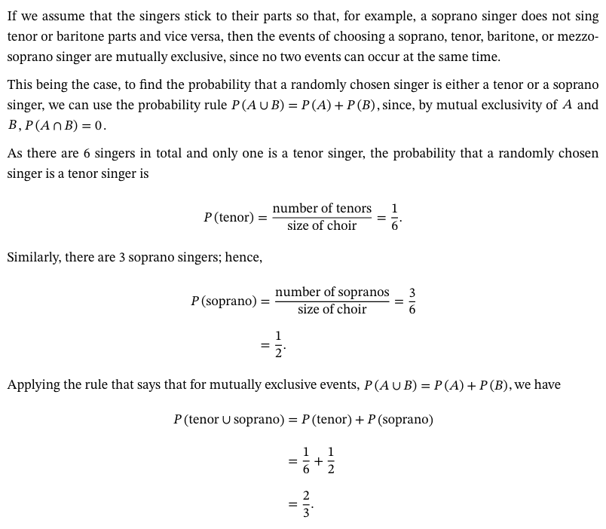
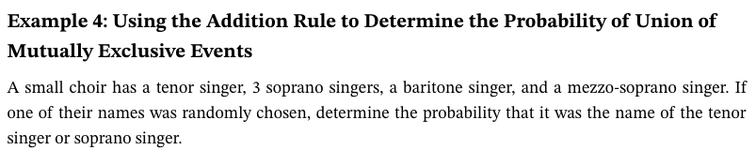
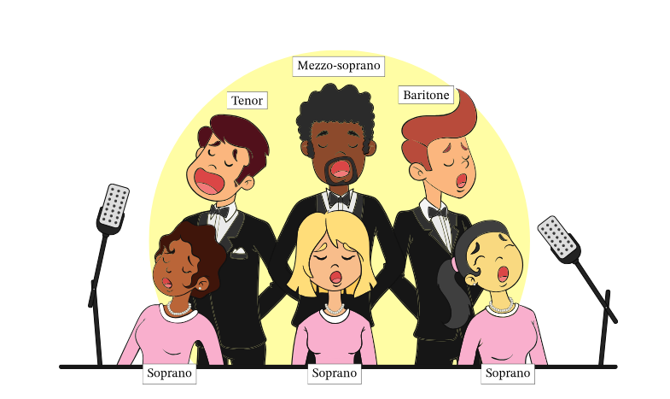
Mutually Exclusive/Disjoint Events
Examples
Image credit - https://www.nagwa.com/

Slide 11
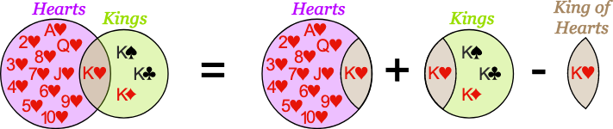
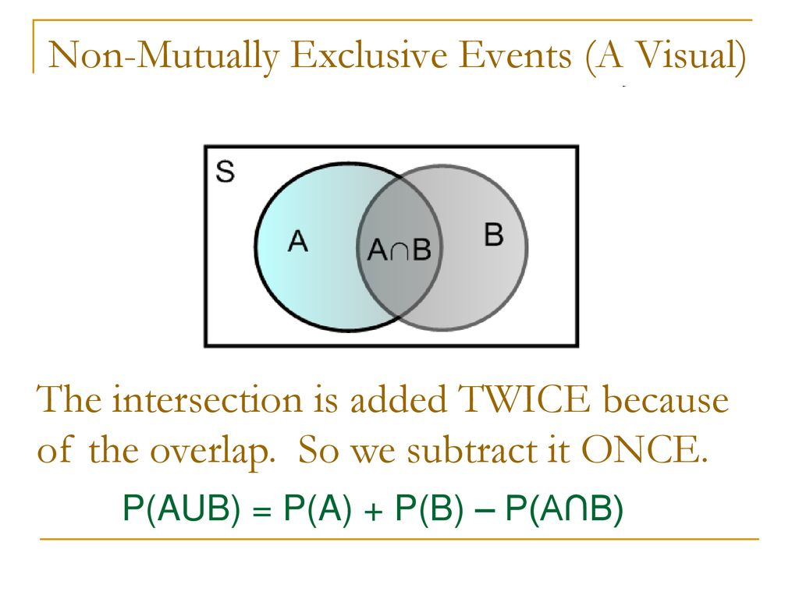
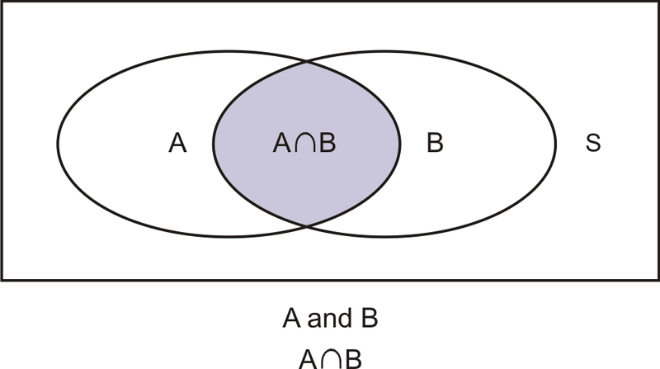
Non-Mutually Exclusive/Union Events
Non-mutually exclusive events are events that can happen at the same time. Examples include: driving and listening to the radio, even numbers and prime numbers on a die, losing a game and scoring, or running and sweating. Non-mutually exclusive events can make calculating probability more complex.
For example, in the case of rolling a die the event of getting an ‘odd-face’ and the event of getting ‘less than 4’ are not mutually exclusive and they are also known as compatible event.
Image credit - https://www.mathsisfun.com/
Image credit - https://www.ck12.org/
Image credit - https://slideplayer.com/slide/15912209/

Slide 12
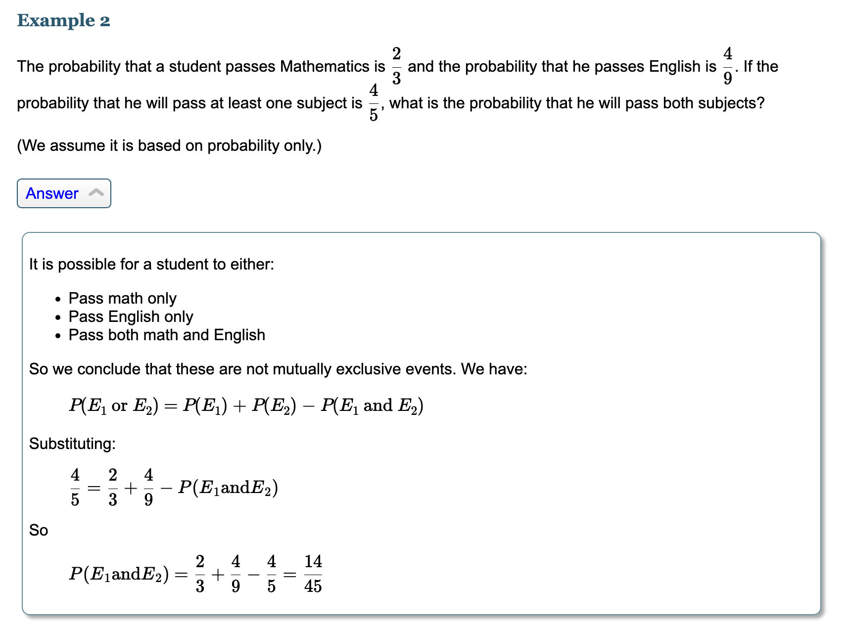
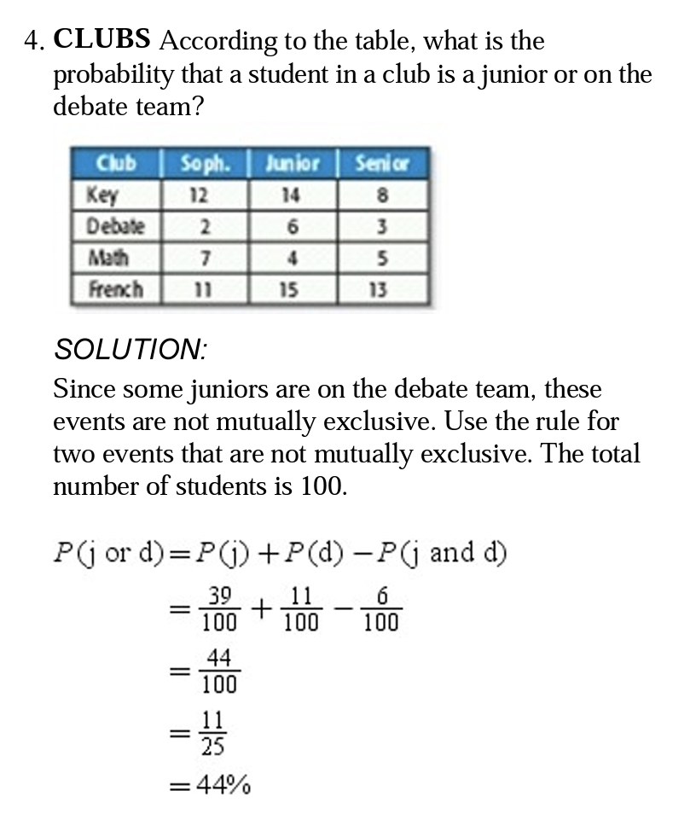
Non-Mutually Exclusive/Union Events
Examples
Image credit - www.chino.k12.ca.us
Image credit - https://www.intmath.com/

Slide 13
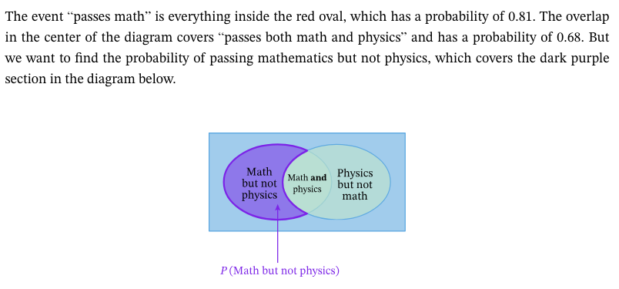
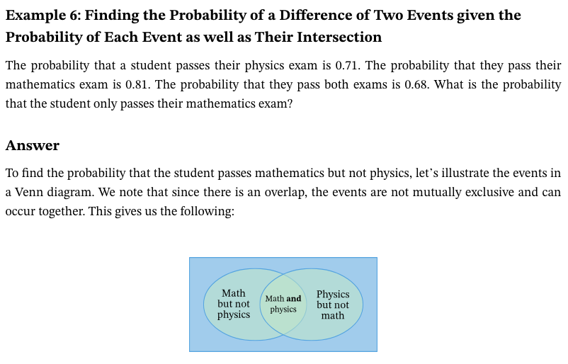
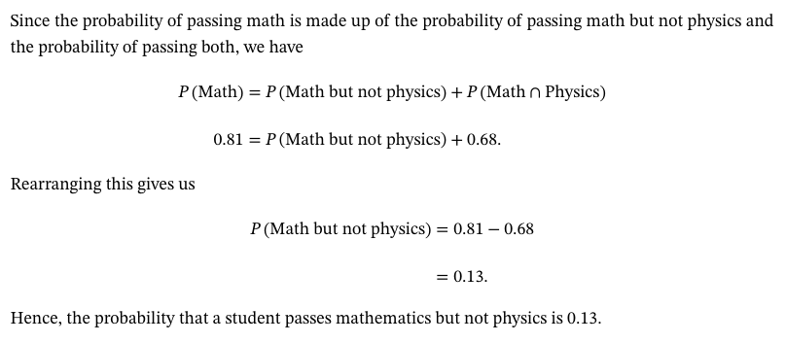
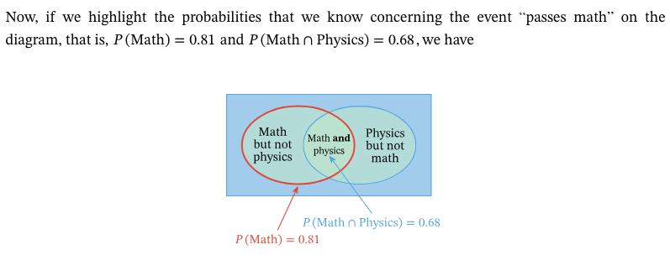
Non-Mutually Exclusive/Union Events
Examples
Image credit - https://www.nagwa.com/

Slide 14
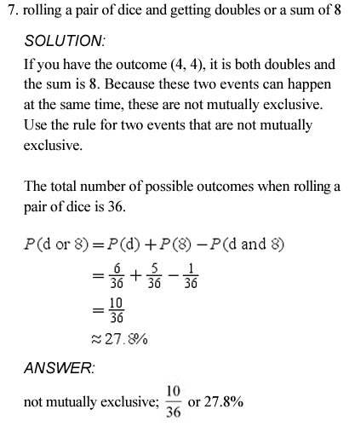
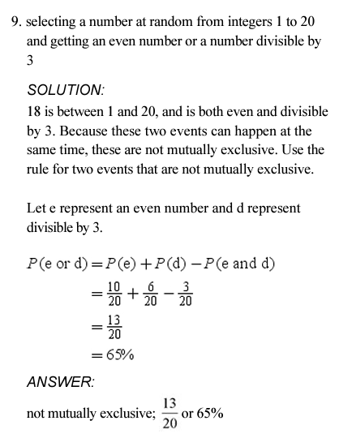
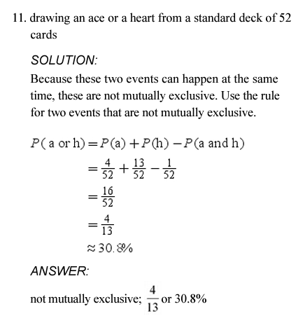
Non-Mutually Exclusive/Union Events
Examples
Image credit - https://school.ckseattle.org

Slide 15
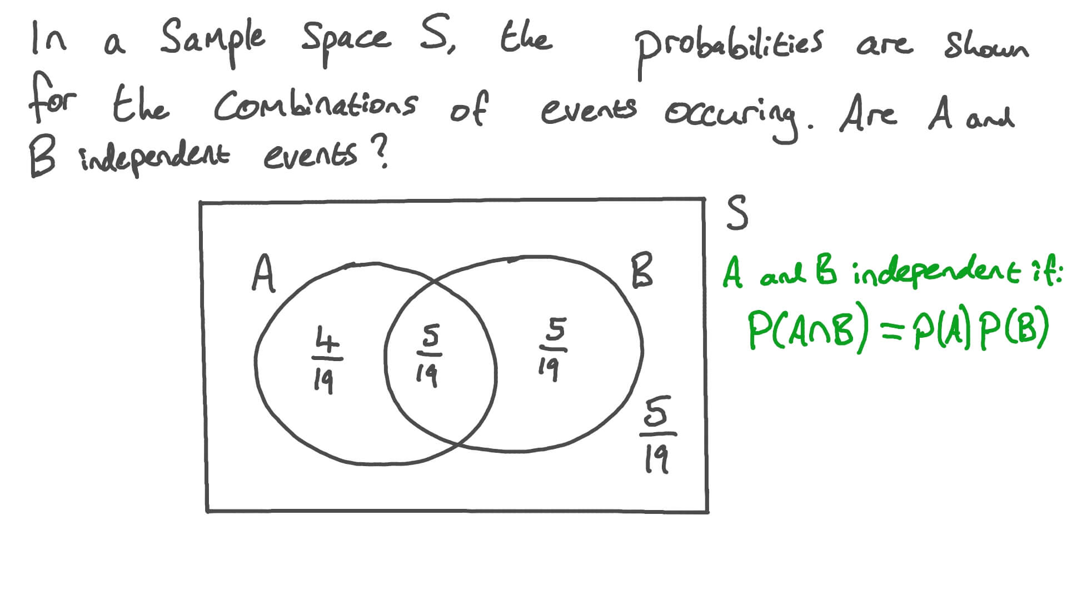
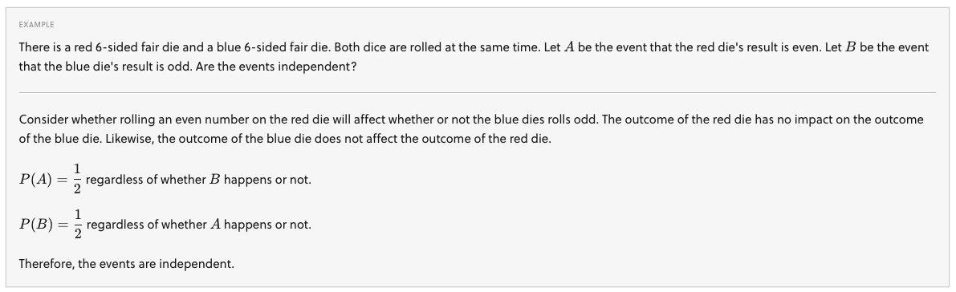
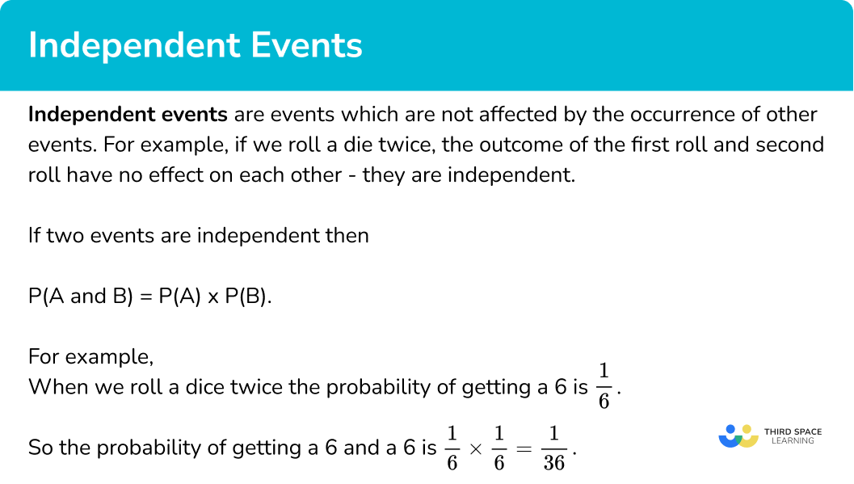
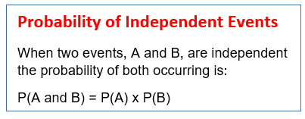
Independent Events
In probability, two events are independent if the incidence of one event does not affect the probability of the other event. If the incidence of one event does affect the probability of the other event, then the events are dependent.
Image credit - https://www.nagwa.com/
Image credit - https://brilliant.org/

Slide 16
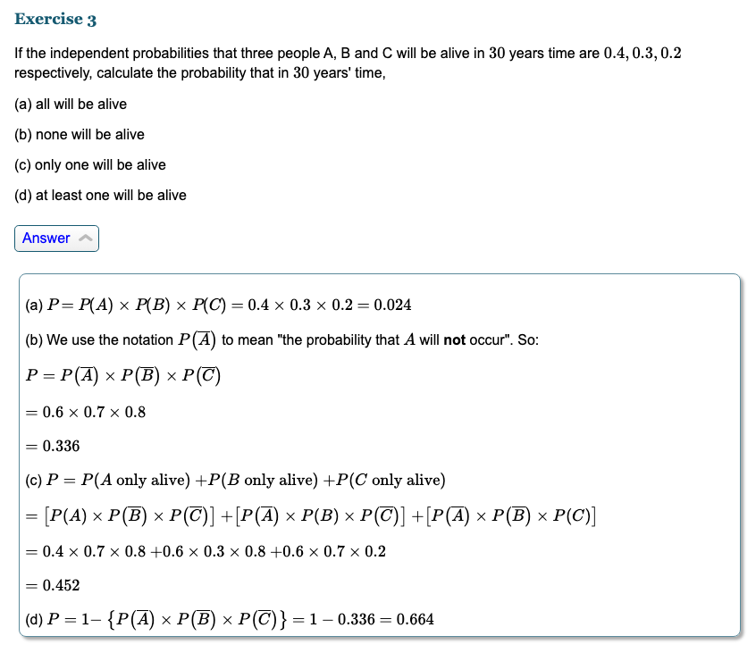
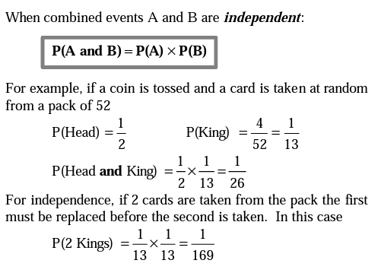
Independent Events
Examples
Image credit - www.nuffieldfoundation.org
Image credit - https://www.intmath.com/

Slide 17
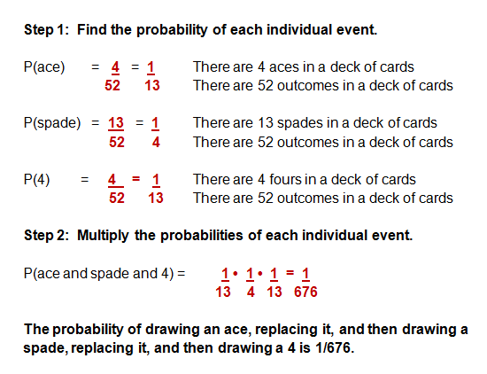
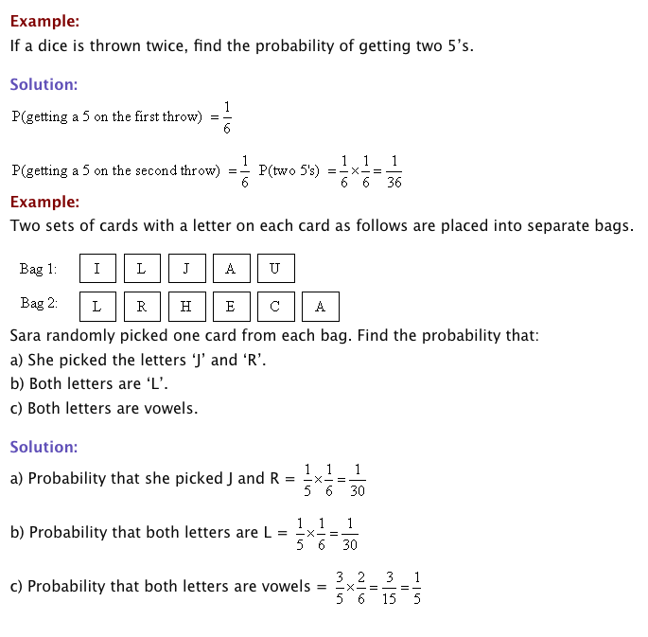
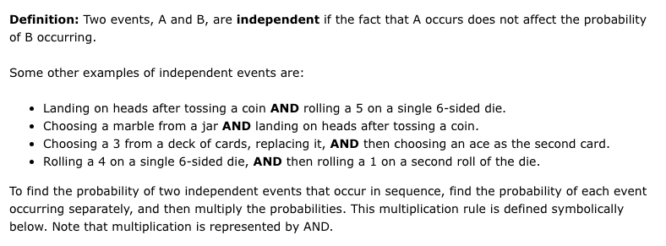
Independent Events
Examples
Image credit -https://www.algebra-class.com/
Image credit - https://www.onlinemathlearning.com/

Slide 18
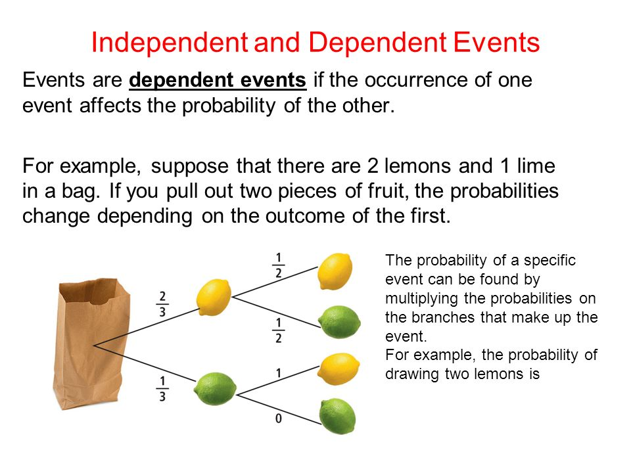
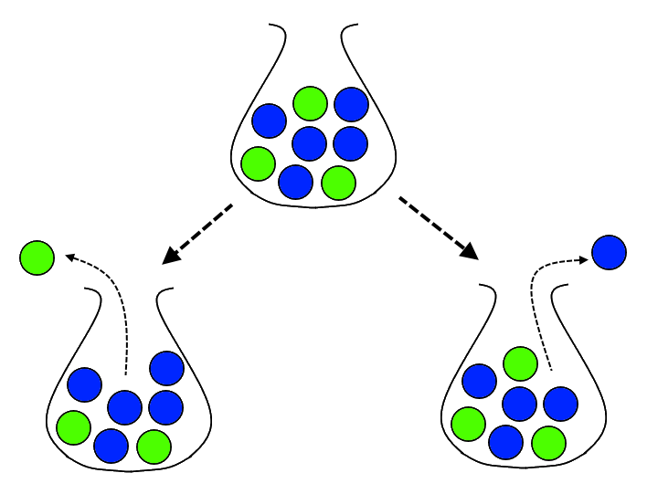
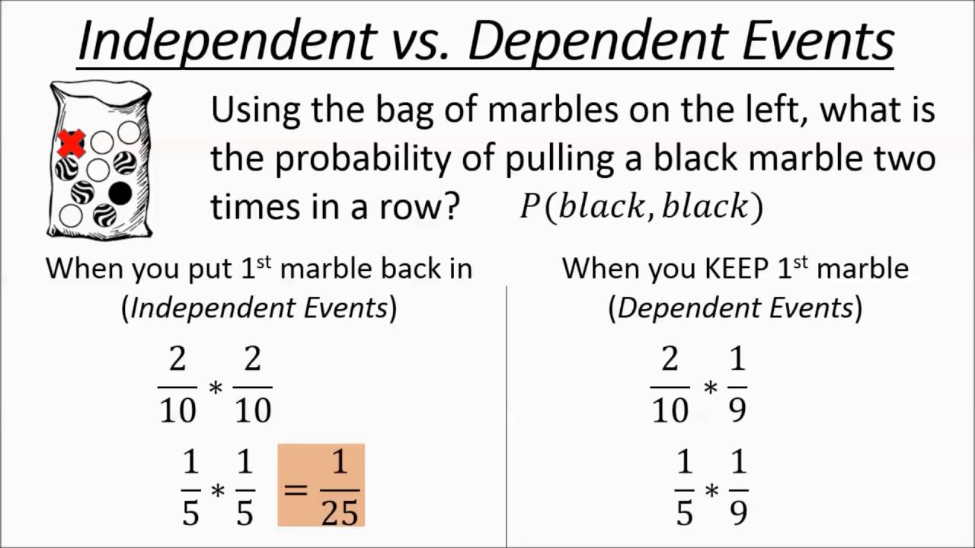
Dependent Events
Dependent events: Two events are dependent when the outcome of the first event influences the outcome of the second event.
Suppose a bag has 3 red and 6 green balls. Two balls are drawn from the bag, one after the other. Let A be the event of drawing a red ball in the first draw and B be the event of drawing a green ball in the second draw. If the ball drawn in the first draw is not replaced back in the bag, then A and B are dependent events because P(B) is decreased or increased according to the first draw results as a red or green ball.
Image credit - https://brilliant.org/

Slide 19
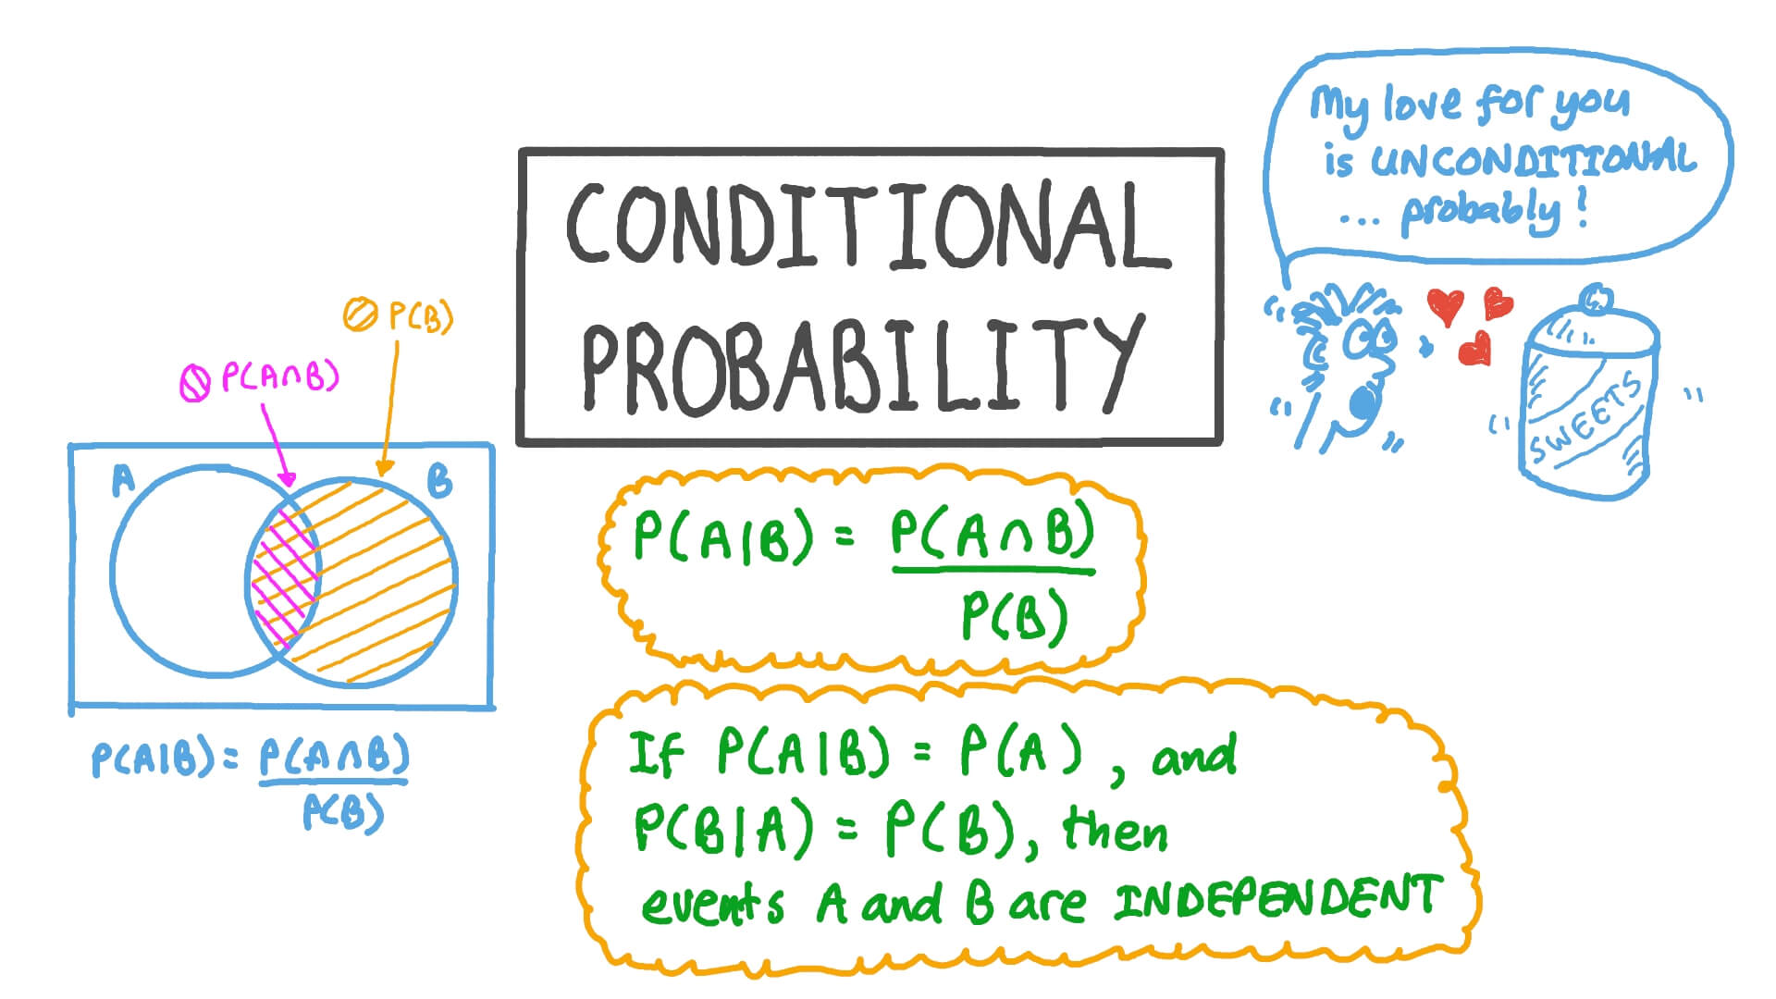



Dependent Events - Conditional Probability
Conditional probability is defined as the likelihood of an event or outcome occurring, based on the occurrence of a previous event or outcome.
The conditional probability of an event B is the probability that the event will occur given the knowledge that an event A has already occurred. This probability is written P(B|A), notation for the probability of B given A.
In the case where events A and B are independent (where event A has no effect on the probability of event B), the conditional probability of event B given event A is simply the probability of event B, that is P(B).
Image credit - https://www.nagwa.com/
Image credit - https://calcworkshop.com/
Image credit - https://stats.stackexchange.com/

Slide 20



Conditional Probability
Examples

Slide 21


Conditional Probability
Examples

Slide 22



Conditional Probability
Examples
Image credit -https://www.mathgoodies.com/

Slide 23



Conditional Probability
Examples
Image credit - https://www.probabilitycourse.com/

Slide 24



Chapter Summary - Formula Sheet
Image credit - https://theacetutors.com/
Image credit - https://getcalc.com/
Image credit - rita @ Medium

